Slide 1
Case study: How does a bike-share navigate speedy success?
Google Data Analytics - Coursera

Slide 2
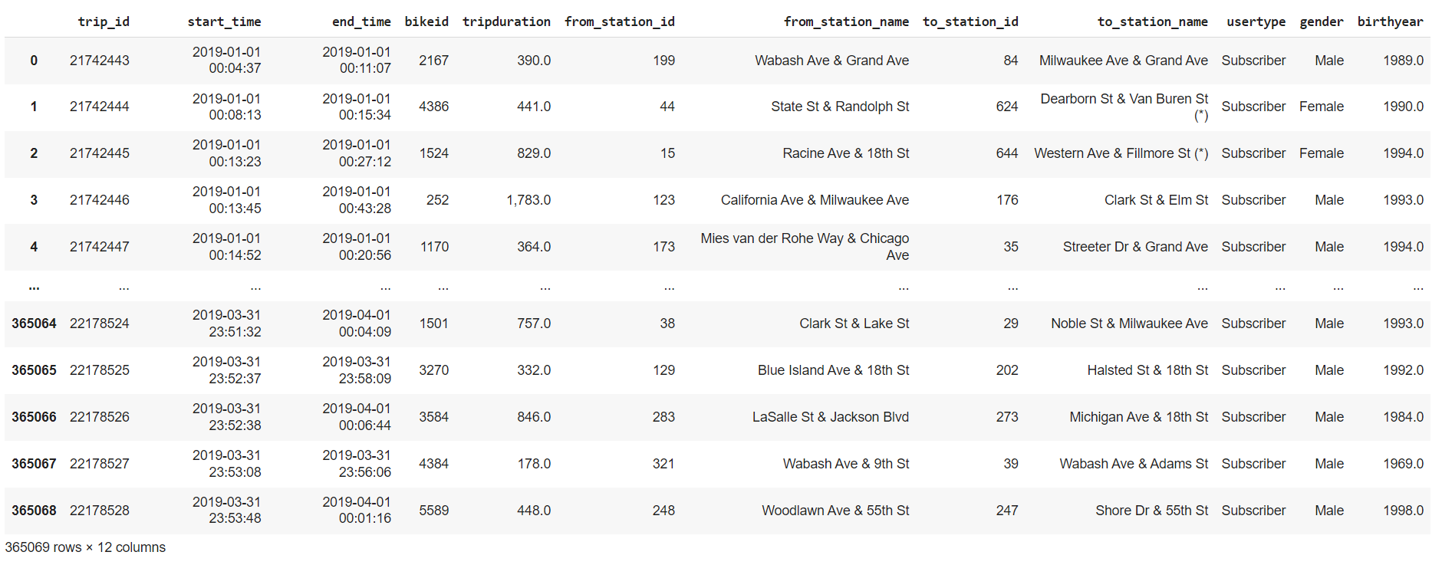
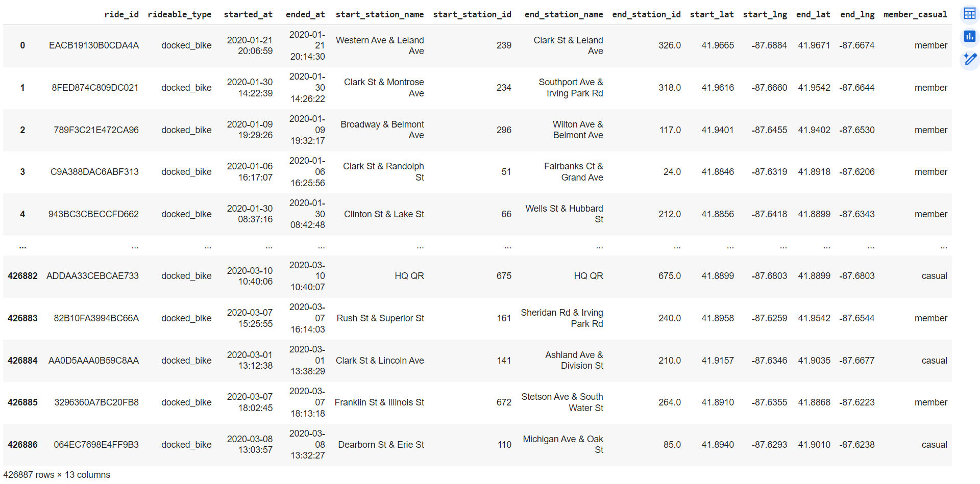
Initial Data – Structured Format
2019
2020

Slide 3
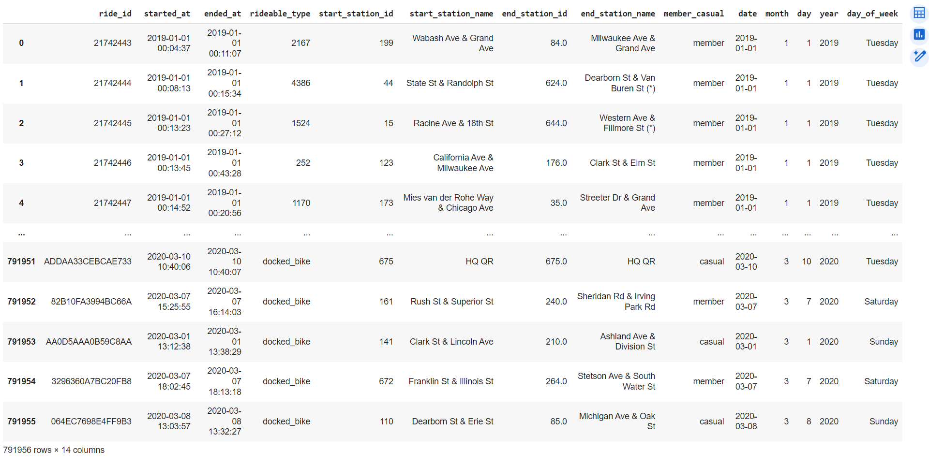
Pre-processed Data – Structured Format

Slide 4
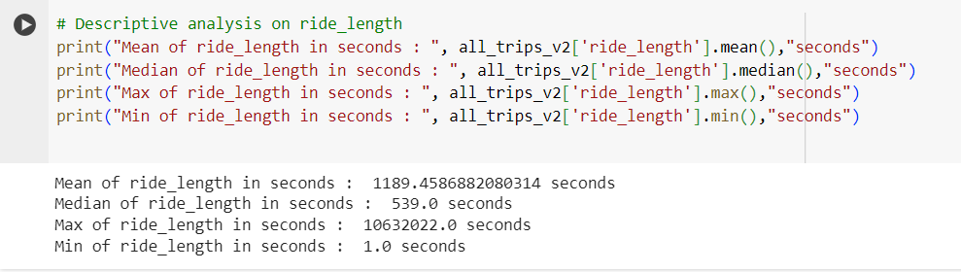
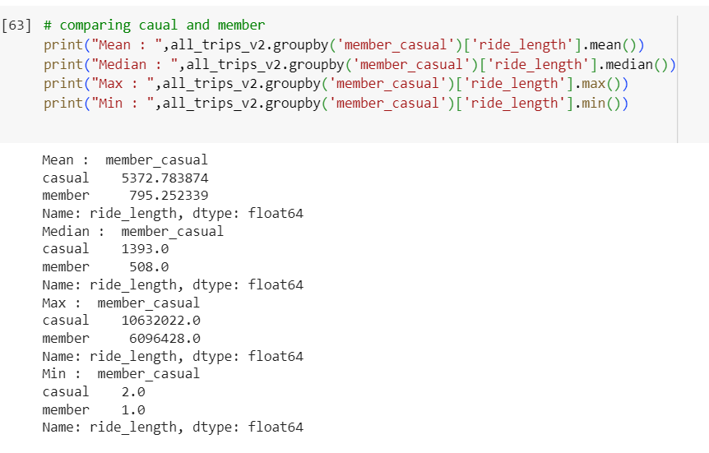
Analysis
Descriptive Analysis
Descriptive Analysis
(Members vs Casuals)

Slide 5
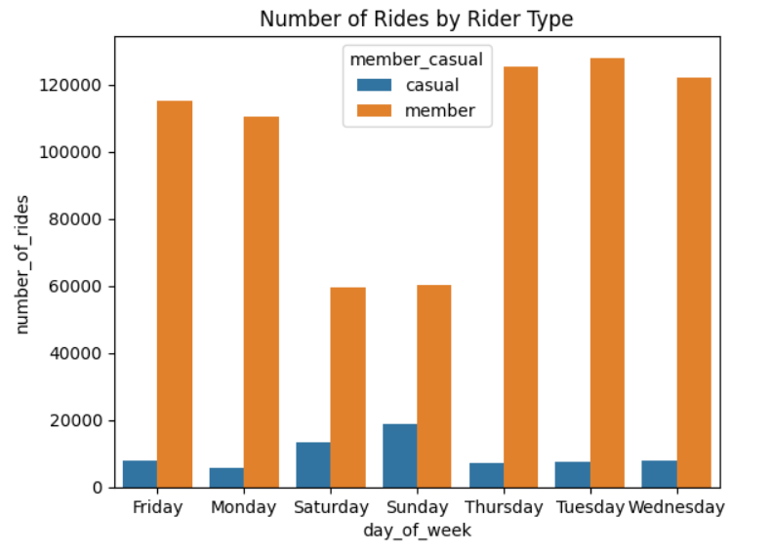
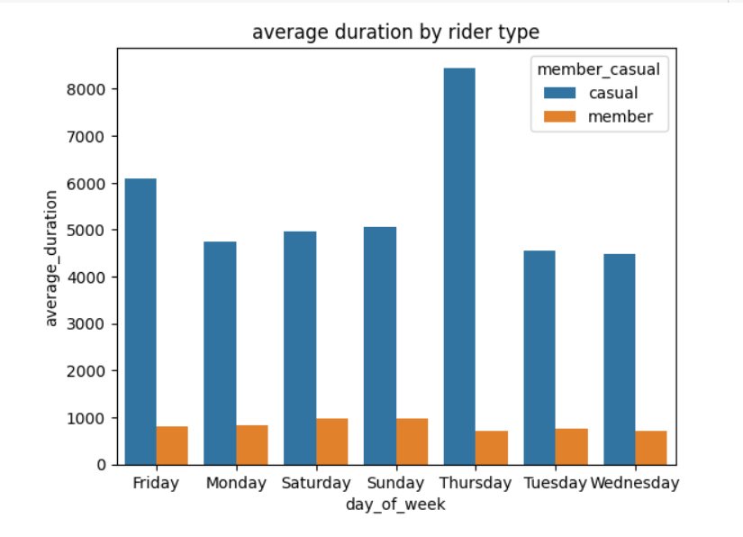
Visualization

Slide 6
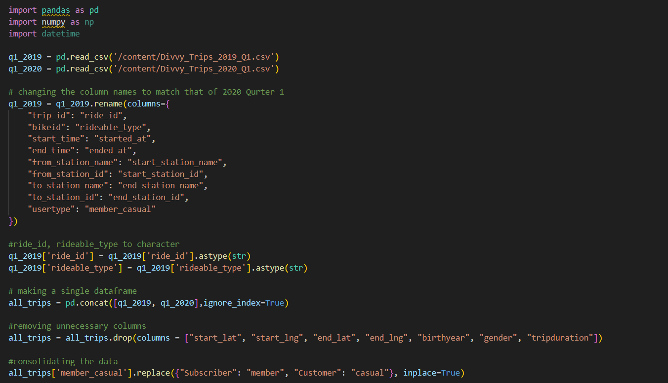

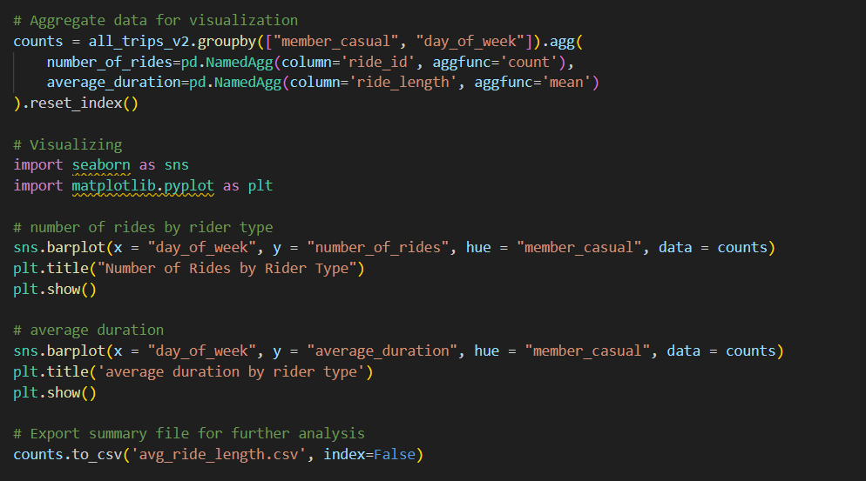
Code

